Slide 1
Final Project
Here is where your project begins

Slide 2

PROJECT PRESENTATION
ON
REAL TIME TRAFFIC SIGNAL RECOGNITION USING CNN
PRESENTED BY:
MANISH VERMA E-11080/19
NEHA MAURYA E-11081/19
ROHIT YADAV E-11082/19
VAIBHAV SINGH E-11083/19
Under the guidance of
Er. Yogendra Kushwaha (Advisor)
Er. Ritika Yaduvanshi (Co-Advisor)
DEPARTMENT OF COMPUTER SCIENCE ENGINEERING
Mahamaya College of Agricultural Engineering & Technology Ambedkar Nagar, Akbarpur
(Acharya Narendra Deva University of Agriculture & Technology, Ayodhya)

Slide 3
01.
INTRODUCTION
05.
FINAL OUTCOMES
02.
OBJECTIVE
CONCLUSION
06.
REVIEW OF LITERATURE
03.
04.
METHODOLOGY
CONTENT
07
FUTURE SCOPE
08
REFERENCES

Slide 4
INTRODUCTION
We always come across incidents of accidents where drivers’ Overspeed or lack of vision leads to major accidents. In winter, the risk of road accidents has a 40-50% increase because of the traffic signs’ lack of visibility. So here in this article, we will be implementing Traffic Sign recognition using Convolutional neural network. It will be very useful in Automatic Driving Vehicles.
Traffic Sign Classification is very useful in Automatic Driver Assistance Systems

Slide 5
Continued…….

Slide 6
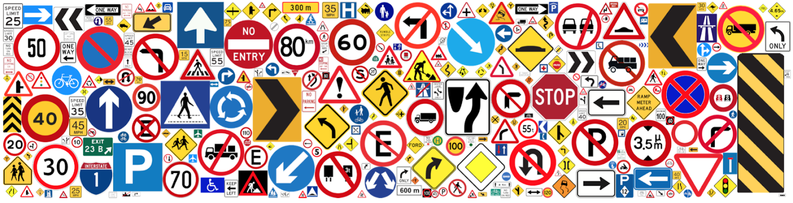
Data collection in project
The dataset for this project is downloaded from the site name Kaggle. The dataset contains more than 50,000 images of different traffic signs. It is further classified into 43 different classes. The dataset is quite varying, some of the classes have many images while some classes have few images.

Slide 7
WHAT IS CNN?
Convolutional Neural Network
Types of artificial neural network.
Network architecture for deep learning algorithms.
Used for image recognition.
Highly suitable for computer vision.

Slide 8
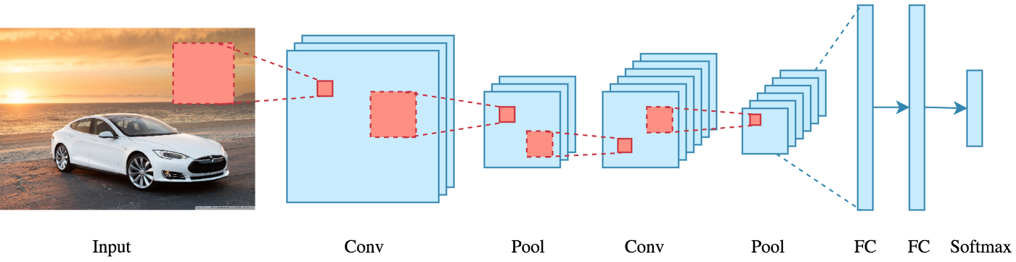
The above image shows how a CNN algorithm work with a given data. It first extracts the required features from the given data and then classify if on bases on that information.

Slide 9
OBJECTIVE
The main objective of the Traffic Sign recognition project is to identify a traffic sign from a place and digital photograph.
The sign may be viewed from various angles and in many diverse background situations.
Traffic sign will then be highlighted after identification and classify signs with a high accuracy rate. All image processing will be done in CNN.

Slide 10
REVIEW OF LITERATURE
S.No. | AUTHOR | TITLE | USED TECHOLOGY
1. | Liu, H., Luo, L., & Cao, Z. (2017). | Traffic Light Detection via Deep Convolutional Neural Networks. | It utilized a region proposal network and a traffic light classification network.
2. | Hsu, G. S., Chen, H. H., & Chuang, Y. L. (2019) | Traffic Sign Recognition Based on Improved YOLOv2 and Region Proposals. | The techniques used in this study can be adapted to real-time traffic signal recognition systems.

Slide 11
REVIEW OF LITERATURE
S.No | AUTHOR | TITLE | USED TECHOLOGY
3. | Li, J., Mei, T., Zhang, Y., Xu, X., & Wang, L. (2017). | Fast Traffic Sign Recognition Based on Convolutional Neural Networks. | It focused on optimizing the CNN model to achieve real-time performance by reducing the computational complexity while maintaining high accuracy in traffic sign recognition.
4. | Khan, M. R., Raza, A., & Mahmood, A. (2020) | Traffic signal recognition based on deep learning, multimedia Tools and Applications. | It covers various CNN architectures and their applications in traffic signal recognition.

Slide 12
METHODOLOGY
Software Prerequisites:
Python 3.8
Visual studio Code
NumPy (version 1.16.5)
CV2(OPENCV) (version 3.4.2)
Kera's (version 2.3.1)
TensorFlow (as keras’s uses TensorFlow in backend and for image preprocessing) (version 2.0.0)
Hardware Prerequisites:
8 GB RAM
I5 INTEL CORE PROCESSOR
1 TB HDD
WINDOW 10
X 64 BIT

Slide 13
Steps involved in Traffic Sign Recognition Using CNN
Dataset collection and preprocessing.
Dataset splitting.
CNN model architecture.
Training the CNN model.
Model evaluation.
Testing the model.
Post-processing and deployment

Slide 14

SDLC

Slide 15
WATER FALL MODEL
Water fall model is a sequential approach, where each fundamental activity of a process represented as a separate phase arranged in linear order.
In water fall model next phase start after completion of previous phase.
With the help of this model we plan and schedule all activities before starting or working on them.

Slide 16
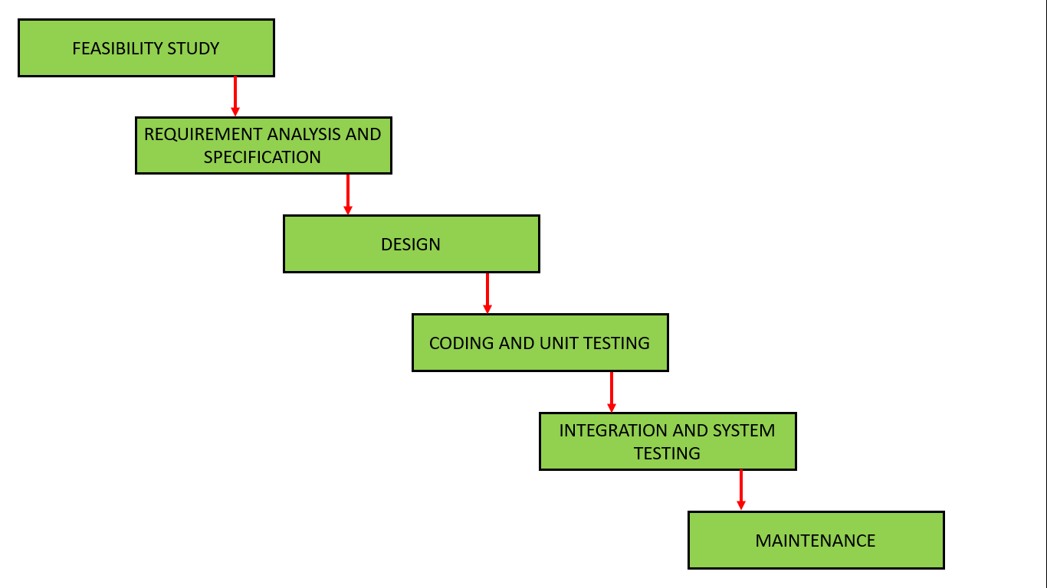
Phases Waterfall Model

Slide 17
Approach Used
The general flow followed by typical sign detection algorithms.
Input
Segmentation
Feature extraction
Detection
OUTPUT

Slide 18
DATA FLOW DIAGRAM
Input image
Preprocessing
segmentation
Shape detection
Feature extraction
Sign recognition
Voice alert message as sign not detected
If sign match's from data
Voice alert message as sign detected

Slide 19
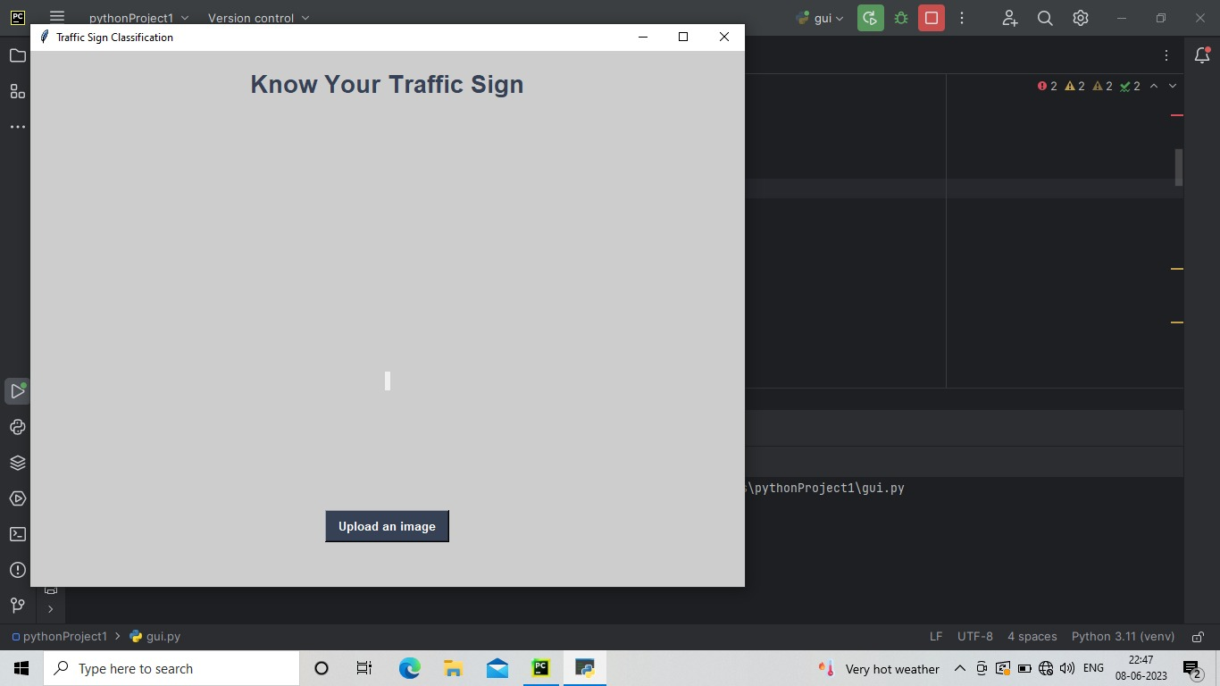
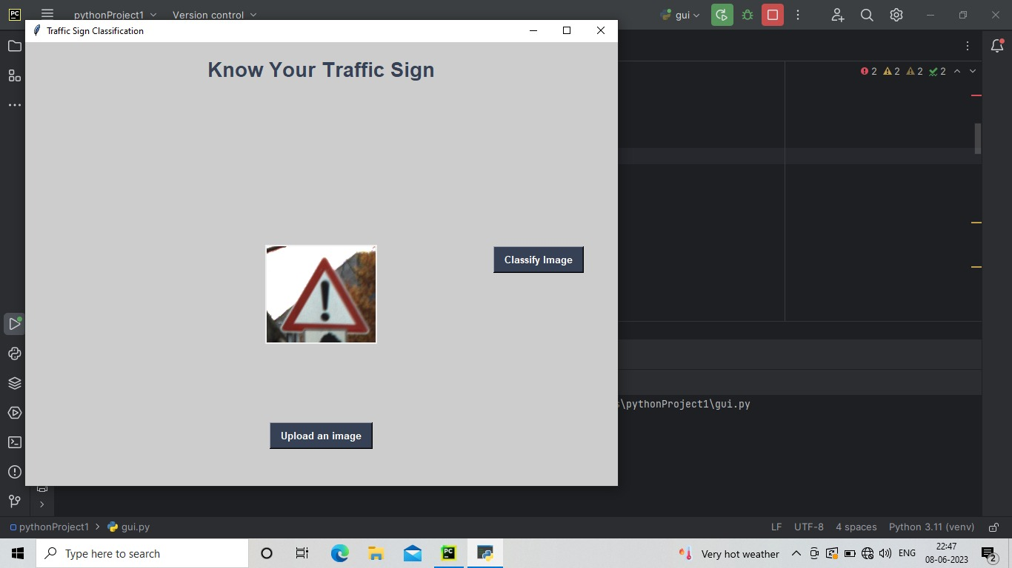
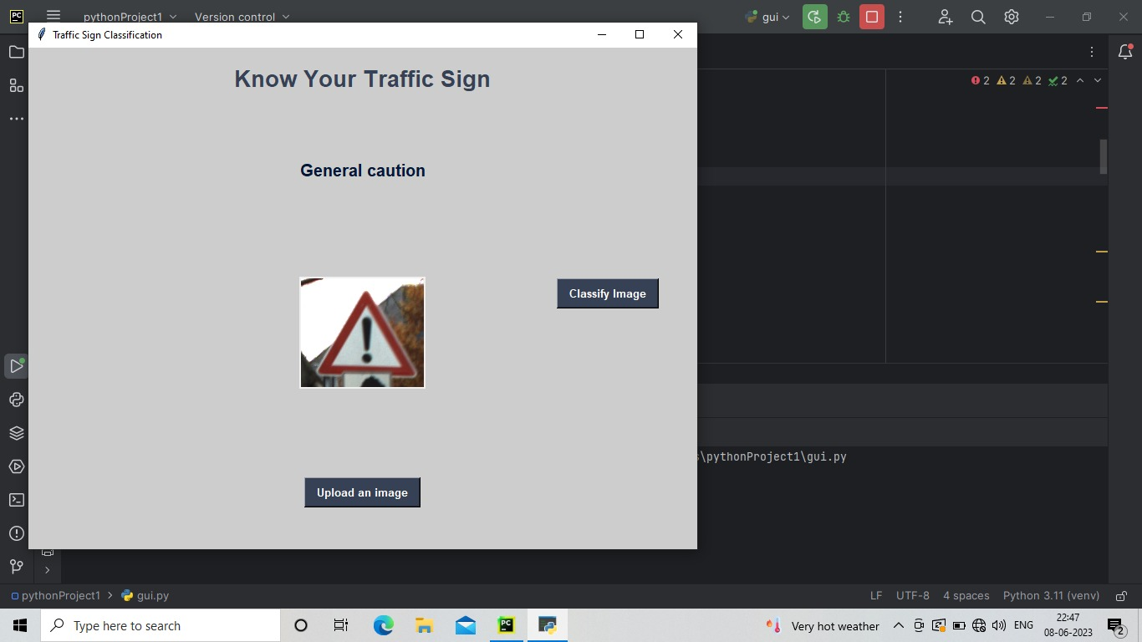
FINAL OUTCOMES
STEP:1
STEP:2
STEP:3

Slide 20
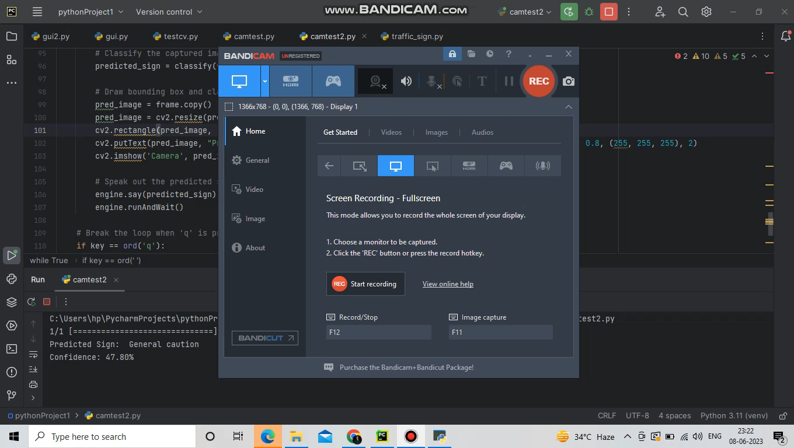
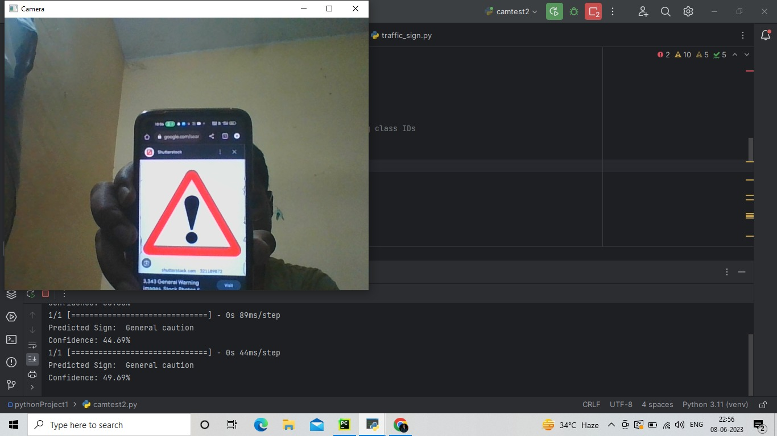
CONTINUE>>>

Slide 21
CONCLUSION
The algorithm that has been used for traffic signs it can be generalized to deal with other kinds of object.
The known difficulties that exists for object recognition in outdoor environments have been considered. This Way the system is immune to lighting changes, occlusions and object deformation being useful for Driver Support System.
Due to this knowledge of sign status, it is believed that the system is useful for other application such as maintenance and inventories of traffic sign in highways and or cities.

Slide 22

Future Scope
Fully Autonomous Vehicles
1. Google’s self-Driving car project.
2.Tom Tom’s highly Automated Diving car project.
Aadvanced Driver Assistant Systems.
1. Mobileye

Slide 23
REFERENCES
[1]. Anonymous (2023) https://onlymyenglish.com/list-of-road-sign-traffic-symbols/ [Accessed 23May.2023].
[2]. T. Guofeng, C. Huairong, L. Yong and Z. Kai, \"Traffic sign recognition based on SVM and convolutional neural network,\" 2017 12th IEEE Conference on Industrial Electronics and Applications (ICIEA), 2017, pp. 2066-2071.
[3]. A. Vennelakanti, S. Shreya, R. Rajendran, D. Sarkar, D. Muddegowda and P. Hanagal, \"Traffic Sign Detection and Recognition using a CNN Ensemble,\" 2019 IEEE International Conference on Consumer Electronics (ICCE), 2019, pp. 1-4.
[4] Anonymous (2023b) www. Pintrest.com
https://bigwater.consulting/2019/04/08/software-development-life-cycle-sdlc/
https://www.geeksforgeeks.org/software-engineering-classical-waterfall-model/

Slide 24
THANK YOU

